Slide 1
MECHANIUM –THE BOT
By-Sarthak S Kumar
Sharada Vidyanikethana Public School,
Mangalore

Slide 2
INSTITUTION AND FACULTY DETAILS
# Name- Sarthak S Kumar # Designation- Student # Contact- 9060880066
# E-mail Id- Sarthakbejai123@gmail.com # Institution address-Devinagar, Talapady, Mangalore # Institution’s’ contact number-08242281232

Slide 3
SYNOPSIS

Slide 4
AIM -
Mobile robots equipped with four Mecanum wheels have the omnidirectional property, which means, they have the ability to move instantaneously in any direction.
They have the ability to easily perform certain tasks in congested environments foreseen with static obstacles, dynamic obstacles or narrow areas. Usually, such environments are found in factory workshops. Hence the resulting needs to create this kind of robotic platforms to satisfy the requirements of various fields.
The characteristics of the Mecanum wheel, a short comparison between this type of wheel and a conventional wheel, as well as the constructive and design solutions previously developed are described in the first part of this paper. Then, some application fields and the related systems based on Mecanum wheel are presented.

Slide 5
PRINCIPLE-
Mechanum Wheels have a hub with rollers oriented in 45 degrees to the axis of rotation which helps them Move in Omni directions in congested areas.

Slide 6
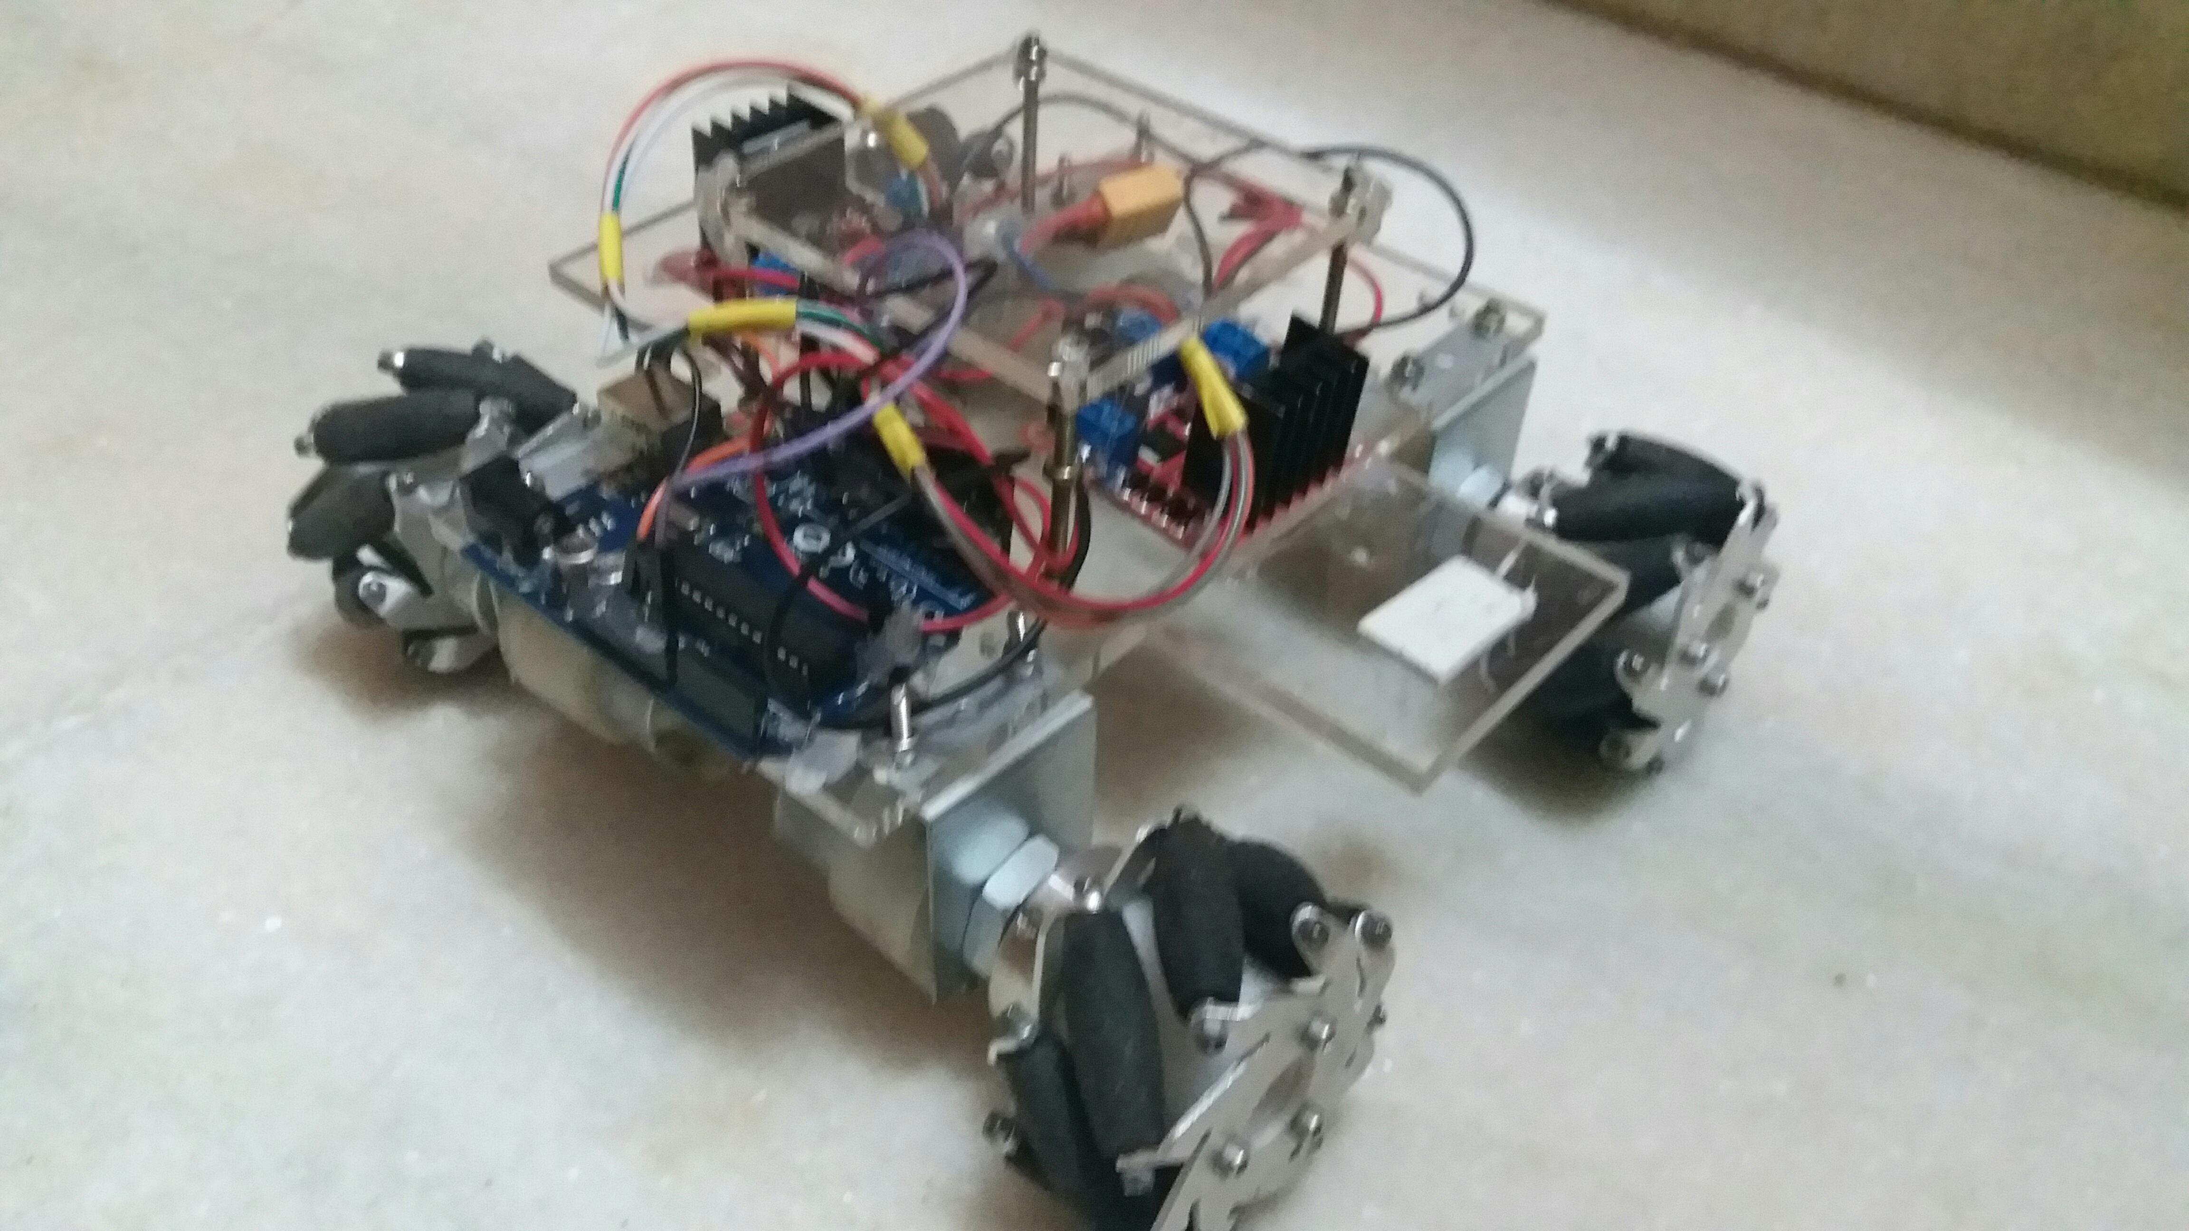
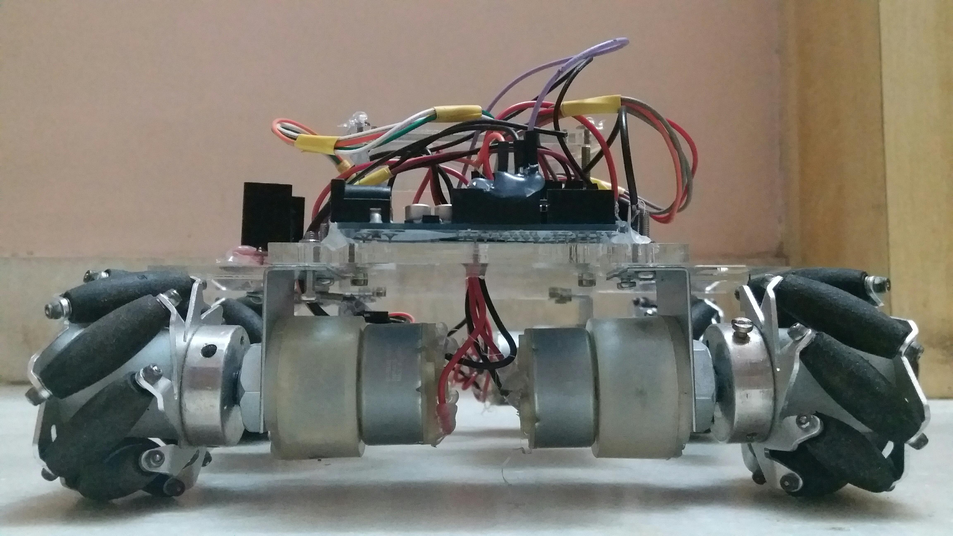
DESIGN-

Slide 7
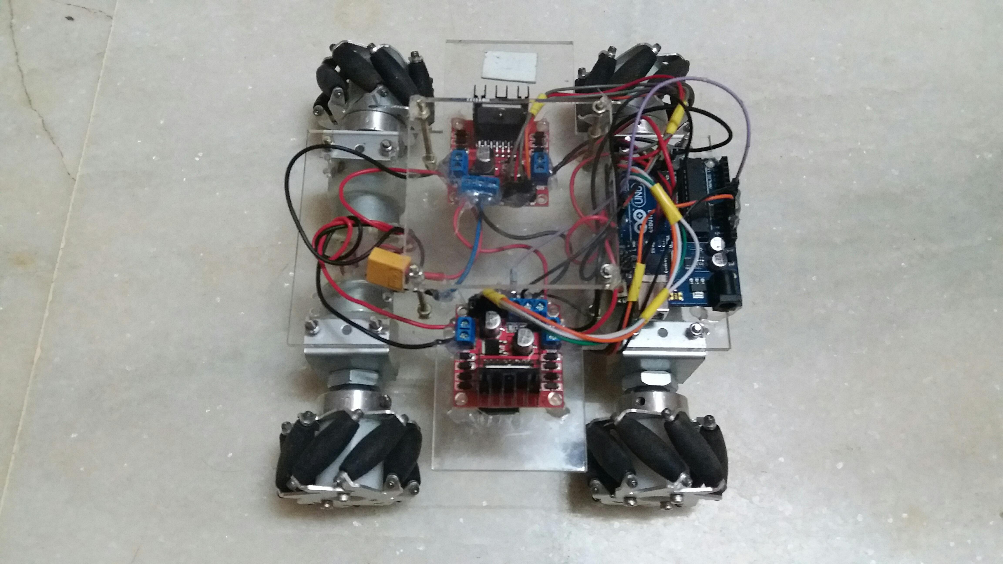
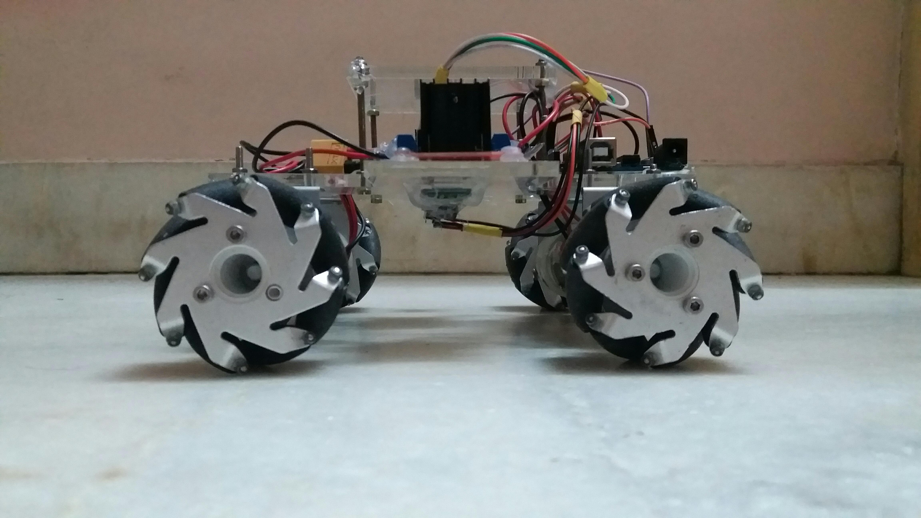
DESIGN-

Slide 8
SUMMARY

